Slide 1

Title: Percentage Increase and Decrease
EQ – How do I increase or decrease an amount by a %?

Slide 2
A few riddles to get you started…….
I exist in life but not in death. You can’t have fun without me. What am I?
What moves without seeing and cries without eyes?
A son and engineer go fishing. The boy was the engineer’s son but the engineer wasn’t the boy’s dad. How was this possible?
What do you throw out when you need it but put away when you don’t?

Slide 3

The letter “f”.
A cloud
The engineer was the boy’s mom.
An anchor

Slide 4
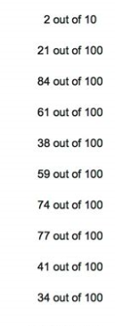
Last lesson Recap
Find the following amounts:
4% of 90
17% of 345
66% of 200
25% of 60

Slide 5
24
7
30
Date
Title: Percentage Increase and Decrease
EQ – How to change an amount by a %?
Why and how?
We change amounts by percentages for sales or GST most commonly.
There are two methods to changing by a percentage
Finding the percentage amount and either adding or subtracting it based on the question
Multiplying by the decimal amount representing the future amount
How to increase an amount by a %?
Increasing a $5.60 sandwich by 10%
Method 1.
Find 10% of $5.60 = $0.56
Add 10% to $5.60 = $6.16
Method 2.
Future amount will be equal to 110% = 1.1
$5.60 × 1.1 = $6.16
5

Slide 6
24
7
30
Date
Title: Percentage Increase and Decrease
EQ – How to change an amount by a %?
We change amounts by percentages for sales or GST most commonly.
There are two methods to changing by a percentage
Finding the percentage amount and either adding or subtracting it based on the question
Multiplying by the decimal amount representing the future amount
Why and how?
How to decrease an amount by a %?
Reducing a $5.60 sandwich by 10%
Method 1.
Find 10% of $5.60 = $0.56
Subtract 10% to $5.60 = $5.04
Method 2.
Future amount will be equal to 90% = 0.9
$5.60 × 0.9 = $5.04
5

Slide 7
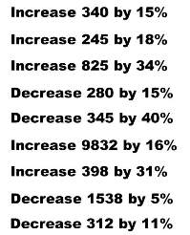

Slide 8
